Slide 1




Local AI Infra Foundations
Prepared by Instructor Team

Slide 2

Contents
Linux environment preparation for AI workloads
GPU driver / runtime setup
CUDA concepts
System paths and environment validation
Local deployment use cases
Privacy, cost, and compliance considerations

Slide 3
Linux environment preparation for AI workloads
Why Linux is the right OS for AI workloads
Flexibility & Architecture: Linux supports generative AI frameworks and agentic patterns without locking you into a single control plane.
Hardware & Performance: Its driver ecosystem aligns with GPU vendors to ease integration, and it offers robust performance tuning for memory-intensive workloads and big data pipelines.
Security & Scaling: Kernel-level security makes enforcing signed binaries and admission control smoother, while container runtimes natively integrate with GPU-optimizing schedulers.
Financial & Operational Freedom: Moving workloads seamlessly across clouds and on-premises clusters avoids recertification and helps rightsize GPU spending.

Slide 4

Linux environment preparation for AI workloads

Slide 5
Linux environment preparation for AI workloads
Choice Of Distribution: The Ubuntu Standard
Ubuntu LTS is the industry standard for AI infrastructure. It is preferred because:
Official Support: NVIDIA provides dedicated .deb packages and repository configurations for every Ubuntu LTS release.
Modern Kernels: Ubuntu 24.04 LTS ships with Linux kernel 6.8 by default, which offers improved hardware support tested against recent NVIDIA drivers.
Ecosystem: The vast majority of Docker containers and deep learning tutorials are built and tested on Ubuntu.

Slide 6
Linux environment preparation for AI workloads (Cont.)
2. GPU Hardware Requirements
The most critical component is a CUDA-capable NVIDIA GPU. while older cards may work, the software capacities are determined by the architecture's Compute Capacity:
Microarchitectures: Modern LLM workloads typically require Volta, Turing, Ampere, Ada Lovelace, or Hopper architectures.
Compute Capability (CC): This defines the computing features supported by a GPU generation. For CUDA 12.x, a minimum CC of 3.5 is required, but 7.0 or higher is strongly recommended for deep learning to leverage modern optimizations

Slide 7
Linux environment preparation for AI workloads (Cont.)
2. GPU Hardware Requirements
Microarchitecture | Release Era | Example Chips
Ampere | 2020 | RTX 3060-3090, A100
Ada Lovelace | 2022 | RTX 4060-4090, L4, L40
Hopper | 2022 | H100, H200
Blackwell | 2024 | B200, B300, RTX 50-series, RTX PRO 6000
Vera Rubin | 2026 | Rubin GPU, Vera Rubin Superchip (NVL72)

Slide 8
Linux environment preparation for AI workloads (Cont.)
2. GPU Hardware Requirements
VRAM (Video RAM): This determines the size of the model you can load. Quantization can reduce VRAM requirements by up to 4x (e.g., an INT4 quantized 70B model requires ~35GB instead of 140GB).
  3B Models: ~2B VRAM.
  7B-8B Models: ~4GB VRAM (quantized) to 16GB (FB16)
  70B Models: ~35GB VRAM (quantized), requiring high-end card like the A100 or dual RTX 4090s.
Blackwell (RTX 50-series) Exception: These newer cards require the open kernel module variant of the driver; using the proprietary module will cause initialization failure.

Slide 9
Linux environment preparation for AI workloads (Cont.)
3. System Hardware Requirements
The rest of your system must support the GPU’s data throughput needs:
System RAM: A minimum of 8 GB is required but 16 GB+ is recommended. For massive models, system RAM should ideally be 1.5x the model size to prevent slow performance due to swap usage (e.g., 65GB RAM for a 70B quantized model).
Storage: At least 20 GB of free disk space is required for the CUDA toolkit and drivers. Note that LLM weights themselves require significant additional space (e.g., ~35GB for a 70B quantized model)
CPU: While the GPU handles the “heavy lifting”, the CPU manages sequential tasks and data processing. If CPU is too slow to tokenize or decode data, it can create a bottleneck where GPU utilization drop while waiting for the CPU.

Slide 10
Linux environment preparation for AI workloads (Cont.)
4. Firmware Requirements
Firmware settings can often prevent drivers from loading correctly."
Secure Boot: The primary hurdle for custom kernel modules (like NVIDIA drivers). It should ideally be disabled in BIOS/UEFI, or alternatively bypassed by using signed modules/manual MOK signing.
Privacy & Security Hardware: High-security/air-gapped environments may require TPM 2.0, Self-Encrypting Drives (SEDs), or physical removal of network components.
Hardware Interconnects: Datacenter setups may utilize high-speed links like NVLink for multi-GPU communication, significantly outperforming standard PCIe.

Slide 11
GPU driver/runtime setup
1. The Architecture Of GPU Execution
To prevent dependency hell, you must understand how the layers interact. You do not need to install every layer on the host OS:
The NVIDIA Driver: Talks to the physical GPU. Must be installed directly on the host. The only layer that's version-sensitive at the kernel level — everything else builds on top of it.
The CUDA Toolkit: The compiler and development headers (nvcc). Only needed on the host if you are compiling custom CUDA kernels natively. Avoid installing "just in case" — toolkit installers can bundle their own driver and silently conflict with an existing one, especially on shared/lab machines.

Slide 12
GPU driver/runtime setup
1. The Architecture Of GPU Execution (cont.)
The Framework Runtime: PyTorch, TensorFlow, or JAX. Modern frameworks bundle their own CUDA runtime in their Python wheels. They only require the host to have compatible drivers — this is why you don't need the Toolkit just to run models, only to build new custom ops.
NVIDIA Container Toolkit: The bridge that allows Docker/containerd to access the host's GPU. Relevant once workloads move into containers (later in Optimization/Deployment).

Slide 13
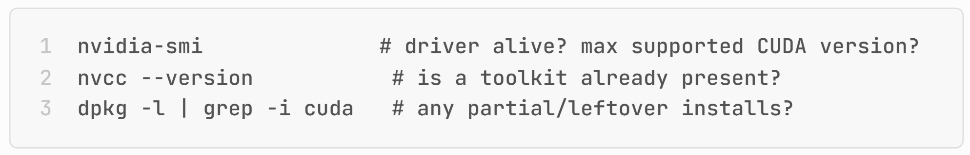
GPU driver/runtime setup
2. Verifying Before You Install
Before touching any layer, check what’s already there:

Slide 14
CUDA Concepts (Conceptual)
What CUDA is: NVIDIA's parallel computing platform—it lets GPU cores run thousands of threads concurrently, which is why matrix-heavy LLM inference/training is fast on GPU vs CPU.
Compute Capability: Every GPU has a version number (e.g., 8.9 for RTX 4090, 9.0 for RTX 5090-class Blackwell)—frameworks/prebuilt binaries target minimum compute capabilities; a mismatch causes "unsupported GPU" errors even with correct drivers.
CUDA vs. driver version compatibility: the driver has a maximum supported CUDA version; toolkits/frameworks below that are fine. Worth showing nvidia-smi's reported "CUDA Version" field is a ceiling, not what's installed.

Slide 15
CUDA Concepts (Conceptual)
VRAM as the real constraint: GPU memory is fixed—unlike system RAM, you can't casually add more—and everything the model needs while running has to share that same fixed pool
  VRAM Calculation : https://apxml.com/tools/vram-calculator

Slide 16
CUDA Concepts
1. Core Architectural Concepts
Streaming Multiprocessors (SM): These are the core execution units inside the GPU. An SM contains the CUDA cores, tensor cores, and registers. Block of thread are scheduled onto the SM for processing.
CUDA Cores: Unlike complex CPU cores designed for the sequential tasks, CUDA cores are simpler arithmetic units designed to perform massive amounts of integer and floating-point math simultaneously.

Slide 17
CUDA Concepts
Core Architectural Concepts
To understand how CUDA runs LLM workloads, you must understand how it organizes hardware and software:
Host vs. Device: In the CUDA ecosystem, the Host refers to the CPU and its system
RAM, while the Device refers to the GPU and its VRAM.
The Hierarchy of Execution:
  Thread: the lowest-level unit of parallel execution.
  Block: A collection of threads (typically in groups of 32, known as a Warp)
  Grid: A collection of blocks that maps to an entire GPU

Slide 18
CUDA Concepts
2. The Processing Flow
A typical CUDA program follows a four-step cycle to process data:
Copy input data from the Host (CPU) memory to the device (GPU) memory.
The CPU initiates a compute kernel (a parallel function) on the GPU.
The GPU’s CUDA core executes the kernel in parallel across the grid of threads.
Copy the resulting data from the device memory back to the Host memory.

Slide 19
CUDA Concepts
3. Memory Hierarchy
Managing memory is critical for AI performance. CUDA uses several memory tiers:
Registers: The fastest memory, private to each thread.
Shared Memory: Very fast memory shared among all threads within a single block; it acts as a user-managed cache.
L2 Cache: Shared across all SMs on the GPU.
Global Memory: The largest capacity (your VRAM) but the slowest tier. This is where model weights are stored.

Slide 20
CUDA Concepts
4. Compute Capability
Compute Capability (e.g., 8.0, 8.9, 9.0) defines the computing features supported by a specific GPU generation.
Why it matters: it determines which instructions (like specialized FP16, INT8 operations)
Requirement: For modern LLMs and CUDA 12.x, a minimum compute capability of 3.5 is required but 7.0 or higher is strongly recommended for deep learning to leverage modern optimization.

Slide 21
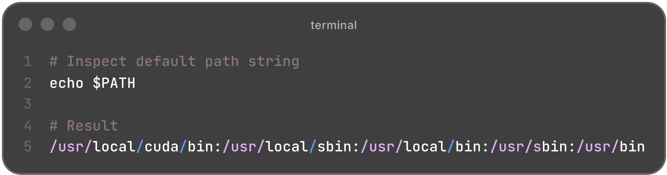
System Paths and Environment Validation
1. Understanding PATH & AI Tooling Variables
PATH is an environment variable, an ordered, colon-separated list of directories. When you type a command, your shell searches these directories in order and runs the first match it finds.

Slide 22
System Paths and Environment Validation (Cont.)
1. Understanding PATH & AI Tooling Variables
PATH controls executables. A separate set of variables controls where AI frameworks store/find things.
Environment Variable | Target System / Tool | Purpose
PYTHONPATH | Python Interpreter | Adds custom module directories to Python's import search path
CUDA_HOME / CUDA_PATH | PyTorch, TF, llama.cpp (CUDA build) | Points to root CUDA installation for compiling custom C++/CUDA kernels
LD_LIBRARY_PATH | Linux C++ Linker | Specifies directories for runtime shared libraries are searched for (.so files)
DYLD_LIBRARY_PATH | MacOS Dynamic Linker | Specifies directories where runtime shared libraries are searched for (.dylib files)

Slide 23
System Paths and Environment Validation (Cont.)
1. Understanding PATH & AI Tooling Variables
Environment Variable | Target System / Tool | Purpose
HF_HOME | Hugging Face Hub | Overrides default storage (~/.cache) for downloaded transformer model weights.
OLLAMA_MODELS | Ollama Engine | Defines directory where local GGUF model blobs are saved and accessed.
NVIDIA_VISIBLE_DEVICES | Docker Container Runtime | Restricts which specific physical host GPUs are passed into a container.

Slide 24
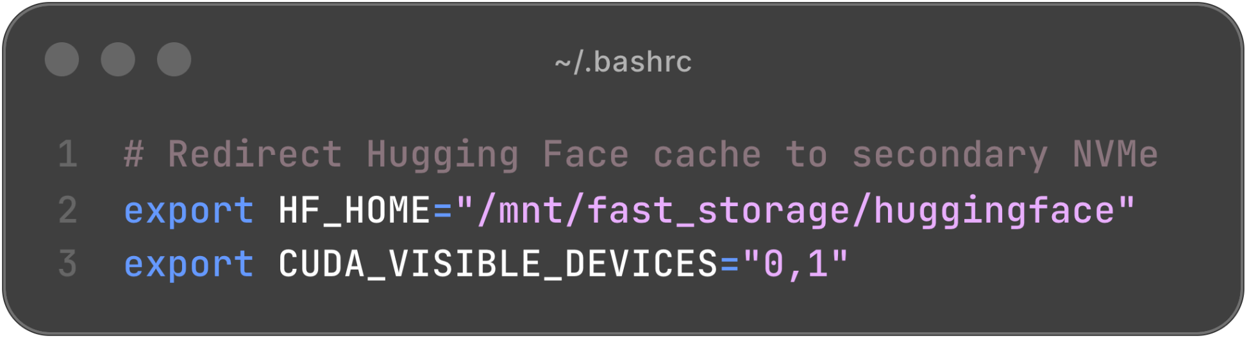
System Paths and Environment Validation (Cont.)
1. Understanding PATH & AI Tooling Variables
Example 1:
Explanation:
[2]: All Hugging Face models and cache will be stored in the
/mnt/fast_storage/huggingface folder.
[3]: Only GPU 0 and GPU 1 are visible and can be used by this program.

Slide 25
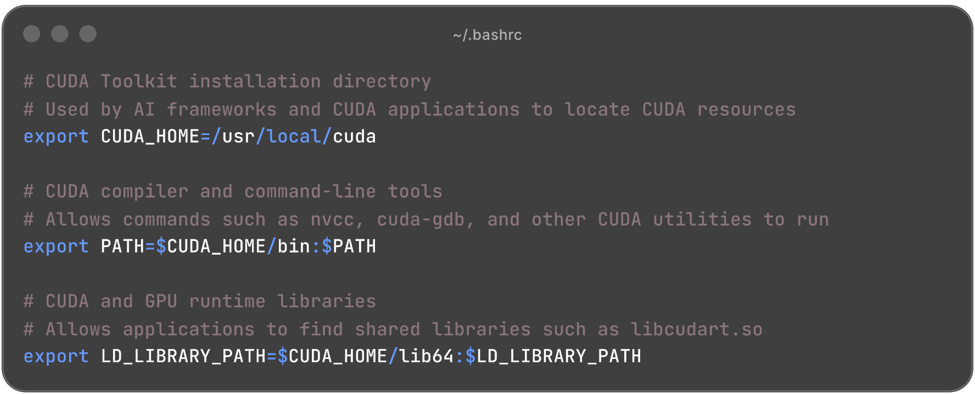
System Paths and Environment Validation (Cont.)
1. Understanding PATH & AI Tooling Variables
Example 2: The common environment paths for Local AI Infra

Slide 26
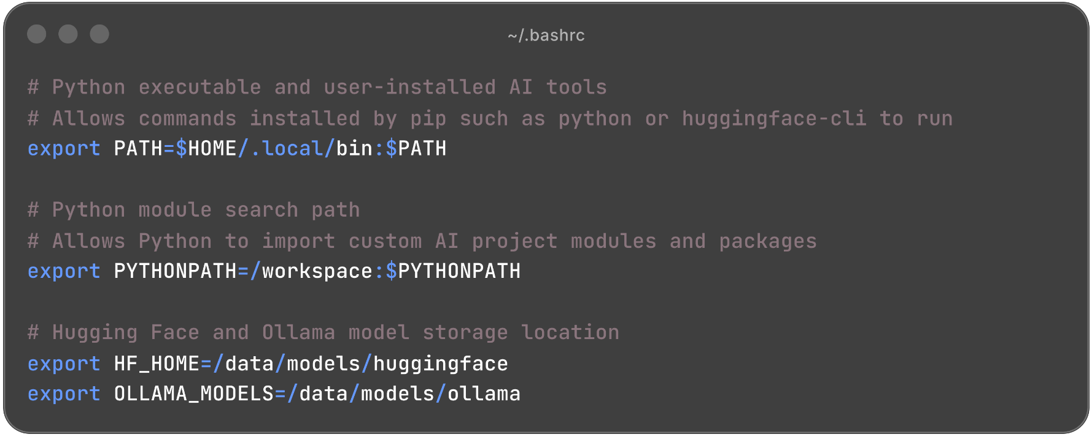
System Paths and Environment Validation (Cont.)
1. Understanding PATH & AI Tooling Variables
Example 2: The common environment paths for Local AI Infra

Slide 27
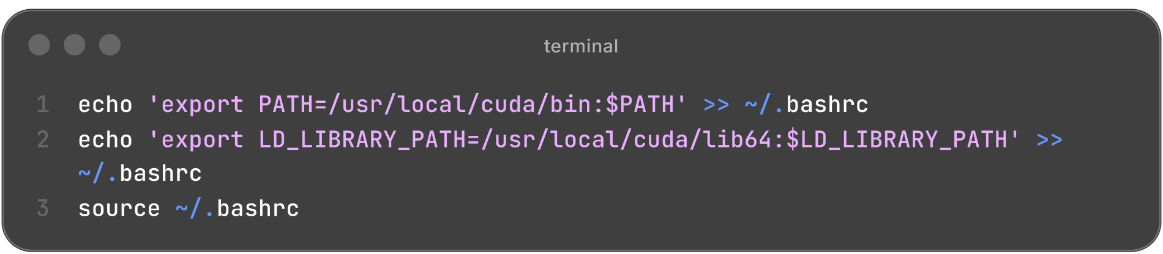
System Paths and Environment Validation (Cont.)
2. Configure Paths
Configure CUDA Environment Paths: After installing the CUDA Toolkit, you have to register its binary executables and shared C/C++ libraries with the shell.
Explanation:
[3]: Reloads the shell configuration file.

Slide 28
System Paths and Environment Validation (Cont.)
3. Validation Reference
Driver Validation: It confirms the NVIDIA driver is not just loaded but functioning, reporting live GPU state.
i. nvidia-smi
Purpose: The primary GPU health check: driver version, live utilization, memory, and active processes.
nvidia-smi

Slide 29
$ nvidia-smi
Mon Jul 20 10:15:42 2026
+-----------------------------------------------------------------------------------------+
| NVIDIA-SMI 550.90.07 Driver Version: 550.90.07 CUDA Version: 13.0 |
|-----------------------------------------+------------------------+----------------------|
| GPU Name Persistence-M| Bus-Id Disp.A | Volatile Uncorr. ECC |
| Fan Temp Perf Pwr:Usage/Cap| Memory-Usage | GPU-Util Compute M. |
| | | MIG M. |
|=========================================+========================+======================|
| 0 NVIDIA GeForce RTX 4070 Off | 00000000:01:00.0 Off | N/A |
| 48% 69C P2 173W / 200W| 9428MiB / 12282MiB | 96% Default |
| | | N/A |
+-----------------------------------------+------------------------+----------------------+
+-----------------------------------------------------------------------------------------+
| Processes: |
| GPU GI CI PID Type Process name GPU Memory |
| ID ID Usage |
|=========================================================================================|
| 0 N/A N/A 1845 G /usr/lib/xorg/Xorg 185MiB |
| 0 N/A N/A 2110 G /usr/bin/gnome-shell 142MiB |
| 0 N/A N/A 5982 C ollama serve 4520MiB |
| 0 N/A N/A 9534 C python monitor_gpu.py 283MiB |
+-----------------------------------------------------------------------------------------+

Slide 30
System Paths and Environment Validation (Cont.)
3. Validation Reference
Driver Validation: Output Breakdown of nvidia-smi
NVIDIA-SMI 550.90.07: The version of the NVIDIA System Management Interface utility.
Driver Version: The version of the installed NVIDIA GPU driver.
CUDA Version: 13.0: The maximum CUDA version this driver supports at runtime.
Persistence-M (Persistence Mode): Shows whether the GPU driver stays loaded even when no applications are running.
  Off (default): Driver unloads when GPU becomes idle.
  On: Driver remains resident in memory.

Slide 31
System Paths and Environment Validation (Cont.)
3. Validation Reference
Driver Validation: Output Breakdown of nvidia-smi
Fan: Shows the current cooling fan speed as a percentage of its maximum RPM.
Fan Speed | Meaning
0-20% | Idle or light workload
20-50% | Moderate workload
50-80% | Heavy AI or gaming workload
80-100% | Maximum cooling during sustained load

Slide 32
System Paths and Environment Validation (Cont.)
3. Validation Reference
Driver Validation: Output Breakdown of nvidia-smi
Temp (Temperature): Current GPU core temperature.
Temperature | Status
25-40°C | Very cool (idle)
40-75°C | Normal usage
75-90°C | High but generally safe
Above 90°C | Too hot; cooling should be checked
95°C up | Thermal throttling likely

Slide 33
System Paths and Environment Validation (Cont.)
3. Validation Reference
Driver Validation: Output Breakdown of nvidia-smi
Perf (Performance State): Performance states range from P0 (highest performance) to P8 (lowest power).
State | Meaning | Typical Usage
P0 | Maximum performance | Heavy AI training, CUDA benchmarks
P3-P4 | Medium performance | Moderate GPU load
P5-P7 | Light Workload | Desktop acceleration
P8 | Idle power-saving mode | Desktop with almost no GPU activity

Slide 34
System Paths and Environment Validation (Cont.)
3. Validation Reference
Driver Validation: Output Breakdown of nvidia-smi
173W / 200W: Current GPU power usage and the maximum power limit.
9428 MiB / 12282 MiB: The memory usage (GPU VRAM).
96%: Measures how busy the GPU's compute cores were during the last sampling interval.
Processes Table: Lists every process currently using GPU memory.
  G: Graphics application (desktop, browser, display server)
  C: CUDA compute application

Slide 35
System Paths and Environment Validation (Cont.)
3. Validation Reference
CUDA Toolkit & Environment Paths Validation
ii. nvcc --version
Purpose: Confirms the CUDA Toolkit compiler is installed and shows the version code will be compiled against.
$ nvcc -–version
nvcc: NVIDIA (R) Cuda compiler driver
Copyright (c) 2005-2024 NVIDIA Corporation
Built on Thu_Mar_28_02:18:24_PDT_2024
Cuda compilation tools, release 12.4, V12.4.131
Build cuda_12.4.r12.4/compiler.34097967_0

Slide 36
System Paths and Environment Validation (Cont.)
3. Validation Reference
CUDA Toolkit & Environment Paths Validation
iii. which nvcc
Purpose: Shows exactly which NVCC binary the shell will execute and resolves ambiguity when multiple CUDA versions are installed side by side.
$ which nvcc
/usr/local/cuda-12.4/bin/nvcc

Slide 37
System Paths and Environment Validation (Cont.)
3. Validation Reference
CUDA Toolkit & Environment Paths Validation
iv. echo $PATH | tr ':' '\n' | grep cuda
Purpose: Verifies CUDA's bin directory (where nvcc lives) is on the executable search path.
$ echo $PATH | tr ':' '\n' | grep cuda
/usr/local/cuda/bin
/usr/local/cuda-12.4/bin
Output Breakdown:
$PATH is normally one colon-separated string; tr ':' '\n' splits it into one entry per line so grep can search line by line.

Slide 38
System Paths and Environment Validation (Cont.)
3. Validation Reference
CUDA Toolkit & Environment Paths Validation
v. echo $LD_LIBRARY_PATH | tr ':' '\n' | grep cuda
Purpose: Verifies CUDA's shared libraries (libcudart.so, libcublas.so, etc.) are discoverable by the dynamic linker at runtime.
$ echo $LD_LIBRARY_PATH | tr ':' '\n' | grep cuda
/usr/local/cuda/lib64
/usr/local/cuda-12.4/lib64

Slide 39
System Paths and Environment Validation (Cont.)
3. Validation Reference
Containerized GPU Access
vi. docker run --rm --gpus all nvidia/cuda:12.4.1-base-ubuntu22.04 nvidia-smi
Purpose: End-to-end proof that Docker can expose the GPU to a container. Its output is the same as the nvidia-smi table but generated from inside a container.
Command Breakdown:
--rm: Deletes the container automatically after exit; this is a one-shot test.
--gpus all: The flag, backed by the container toolkit, that exposes all host GPUs to the container. Omit it, and the container has zero GPU access.
nvidia/cuda:12.4.1-base-ubuntu22.04: an official minimal image bundling the CUDA runtime libraries for 12.4.1 on Ubuntu 22.04.

Slide 40
Local Deployment: Benefits & Advantages
Why run AI locally instead of using a cloud API?
Local AI deployment is the practice of running AI models on your own computer or organization's infrastructure instead of using cloud-based AI services. Key advantages include the following:
Privacy: Sensitive data stays entirely on your local machine or network.
Cost at scale: Fixed hardware investment with zero per-token API fees.
Latency: Eliminates network round-trips to remote cloud servers.
Offline operation: Functions without an active internet connection.
Customization: Full control over fine-tuning, quantization, system prompts, and model selection without rate limits.

Slide 41
Local Deployment: Use Cases
Common scenarios where running AI locally is preferred
Key application scenarios:
Internal Knowledge Base and HR Assistant: Large organizations are deploying private AI assistants to help employees quickly access company knowledge, HR policies, and internal documents. For example, Walmart’s MyAssistant is an internal generative AI assistant designed to help employees with tasks such as answering workplace questions, summarizing documents, and improving productivity. It uses enterprise data and AI models while keeping sensitive company information within Walmart’s controlled environment.

Slide 42
Local Deployment: Use Cases (Cont.)
Common scenarios where running AI locally is preferred
Key application scenarios:
Financial Research and Compliance: Banks are using private AI systems to analyze financial documents, support research, and monitor compliance activities. For example, JPMorgan Chase’s LLM Suite provides employees with an internal AI assistant that can summarize documents, answer finance-related questions, and support investment research. In addition, financial institutions use AI fraud detection platforms such as NICE Actimize to analyze transaction patterns, detect suspicious activities, and support anti-money-laundering (AML) monitoring while keeping sensitive financial data within secure banking systems.

Slide 43
Local Deployment: Use Cases (Cont.)
Common scenarios where running AI locally is preferred
Key application scenarios:
Healthcare Diagnostics and Data Analysis: Healthcare organizations use local AI systems to analyze medical images and patient data while protecting privacy. For example, Aidoc and Zebra Medical Vision use computer vision AI models to analyze X-rays, CT scans, and MRIs to help radiologists detect abnormalities such as brain hemorrhages, fractures, and tumors. Hospitals can deploy these AI solutions within their own infrastructure so patient images remain inside the healthcare network, supporting faster diagnosis while meeting privacy requirements such as HIPAA.

Slide 44
Local Deployment: Use Cases (Cont.)
Common scenarios where running AI locally is preferred
Key application scenarios:
Manufacturing and IoT Operations: Manufacturers use local AI for real-time equipment monitoring, quality inspection, and predictive maintenance. For example, Siemens Industrial Edge AI allows factories to run AI models directly on industrial machines to analyze sensor data and detect equipment problems before failures occur. Companies also use Cognex Vision AI for automated quality inspection, where computer vision models identify defects on production lines in milliseconds.

Slide 45
Local Deployment: Use Cases (Cont.)
Common scenarios where running AI locally is preferred
Key application scenarios:
Customer Experience with Privacy: Companies are using private AI solutions to improve customer service while protecting personal information. For example, Genesys Cloud AI and NICE Enlighten use AI to analyze customer conversations, summarize support interactions, and assist customer service agents. Insurance companies also use AI document processing platforms such as UiPath Document Understanding to analyze claims documents and detect fraud patterns. Deploying these AI capabilities within controlled environments helps organizations protect customer data while improving service efficiency.

Slide 46
Privacy, cost, and compliance considerations
Privacy
Running AI locally keeps sensitive data under your control.
Data stays on local devices or company servers instead of being sent to third-party cloud providers.
Reduces the risk of exposing confidential information such as customer records, source code, financial documents, or intellectual property.
Enables organizations to work with sensitive data even without an Internet connection.
Gives businesses full control over who can access AI systems and stored data.

Slide 47
Privacy, cost, and compliance considerations (Cont.)
2. Cost
Local AI deployment requires a larger upfront investment but can lower long-term operating costs.
Initial Costs | Long-Term Benefits
GPU Hardware | No API usage fees
Storage & Infrastructure | Predictable operating costs
Deployment & Maintenance | Unlimited local inferences
IT Administration | Reduced dependency on cloud providers

Slide 48
Privacy, cost, and compliance considerations (Cont.)
3. Compliance
Data processing activities must align with applicable regional and industry regulations:
GDPR (EU): governs personal data of EU residents; has specific requirements around data processing, storage location, and the right to deletion.
HIPAA (US): governs health information; strict requirements on where and how such data can be processed/stored.

Slide 49
Privacy, cost, and compliance considerations (Cont.)
3. Compliance
Many industries require strict control over where data is processed and stored.
Local AI makes it easier to:
Keep data within organizational or national boundaries (data residency)
Meet regulatory requirements such as GDPR, HIPAA, and SOC 2
Maintain audit logs and access controls
Prevent sensitive information from leaving secure environments
Support industry-specific compliance in healthcare, finance, legal, and government sectors

Slide 50
Privacy, cost, and compliance considerations (Cont.)
4. Deployment Matrix Comparison
Evaluation Dimension | Cloud API Services | On-Premise Local AI
Data Privacy | Transmitted to vendor servers | Enclosed within the enterprise boundary
Cost Model | Variable per-token operational expense | Predictable hardware capital expense
Compliance Alignment | Requires complex third-party audits | Native adherence (GDPR, HIPAA, SOC 2)
System Customization | Restricted to vendor endpoints | Full control over RAG & model architecture

Slide 51
Thank you!

